Slide 1
Spring Garden Meeting
District 196

Slide 2
Topics That Matter
Live Goods & Watering
Creating the Customer Experience
In-Stock
Overstock
Safety

Slide 3
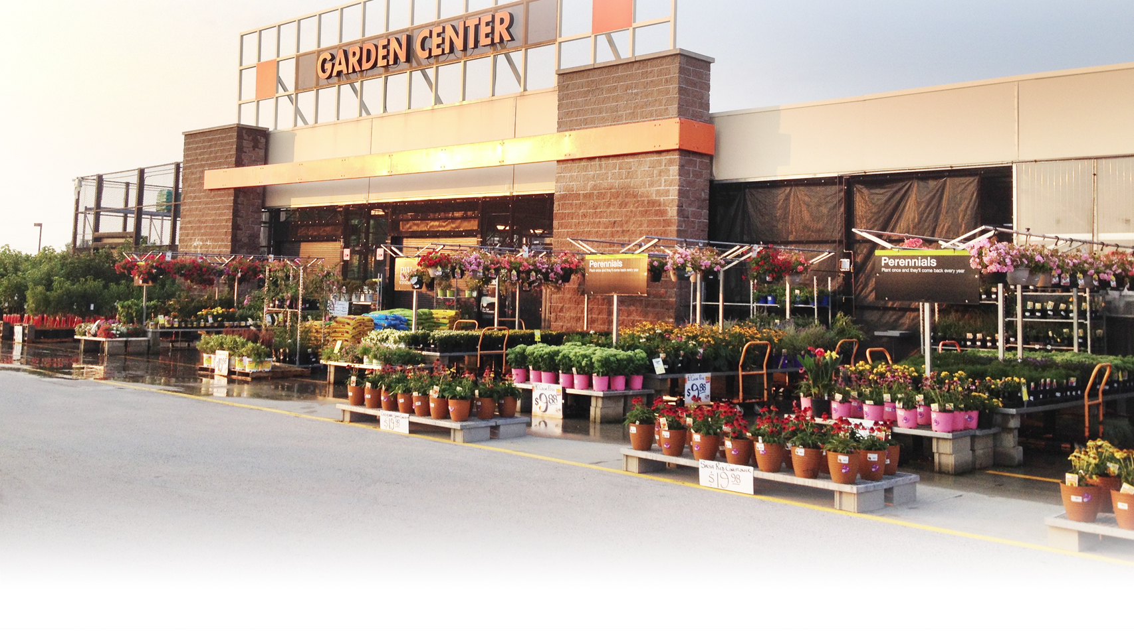
What is Our Responsibility?
LIVE GOODS

Slide 4
Most Live Goods are
Managed by Vendors
Vendors are responsible for:
Merchandising
Pricing
Discarding plants in poor condition

Slide 5
Live Goods:
Our Responsibilities
To ensure the vendors are working to Home Depot standards
Communication is Key. Share ideas and talk about future plans or events
Vendors should be cleaning up after themselves
Any issues should be reported with the respective manager for that vendor

Slide 6
Live Goods:
Our Responsibilities
Shout Out The Values
Have the vendors leave ad plants on plant racks and display by register hut
One plant and one price per cart
This creates less work for vendors and leaves fuller tables once ad has sold through
Watering All Plants Sufficiently

Slide 7
Watering:
A Competitive Advantage?
Well watered, good looking plants are key to giving our Garden Centers that WOW factor
Proper watering keeps the plants in peak condition which lets our customer see the true quality of our plants

Slide 8
Keys to Good Watering
MOD’s and D28 DS are responsible for ensuring watering is getting done
D28 DS should be training all garden associates on proper watering techniques
Occasionally discuss watering techniques in stores opening and closing meetings to make the whole store familiar with the process
Waterers should be scheduled in both the morning and evening

Slide 9
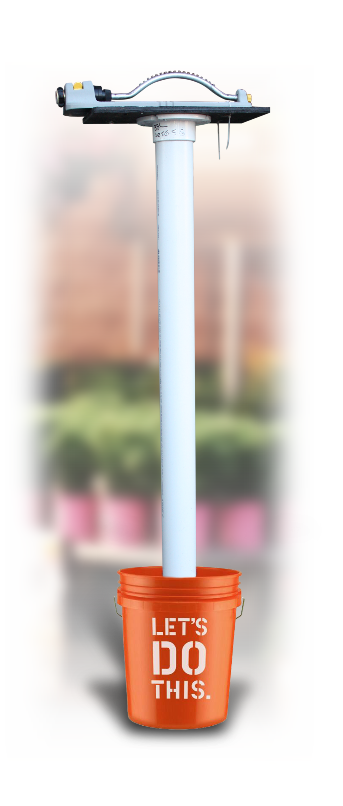
Keys to Good Watering
Sprinkler Stands should be created for the corral, trees, shrubs, and front apron.
The stands will be set up and turned on by a closing garden associate
The sprinklers will run at least 4 hours and then a recovery associate will move them to the next position
The stands should be made with PVC or Wood, 6ft tall and set in concrete inside a homer bucket

Slide 10
Keys to Good Watering
Watering Spikes for Ball and Burlap
These spikes should be made of at least 1.5” diameter PVC cut to ~18” in length with one end cut at a 45 degree angle
One spike will get hammered into the root ball
Just place the end of the hose in the pipe for 1-2 minutes
Put a nickel shutoff valve on the end of the hose to conserve water while moving the hose from plant to plant

Slide 11
Keys to Good Watering
Maintain the live goods watering tracker in the cashier hut
Make map of the Garden Center, front apron and corral (all areas that plants could be)
Laminate this and put up in the cashier hut
Throughout the day waterers will initial off each table/area that they watered with a dry erase marker
This makes it very clear what has been done and allows DS or MOD to go back and inspect the tables to see how well they were watered

Slide 12
Keys to Good Watering
Watering must be made a top priority
Ensure accountability with associates
If watering is not being done or being done improperly, do not be afraid to performance council the associates

Slide 13
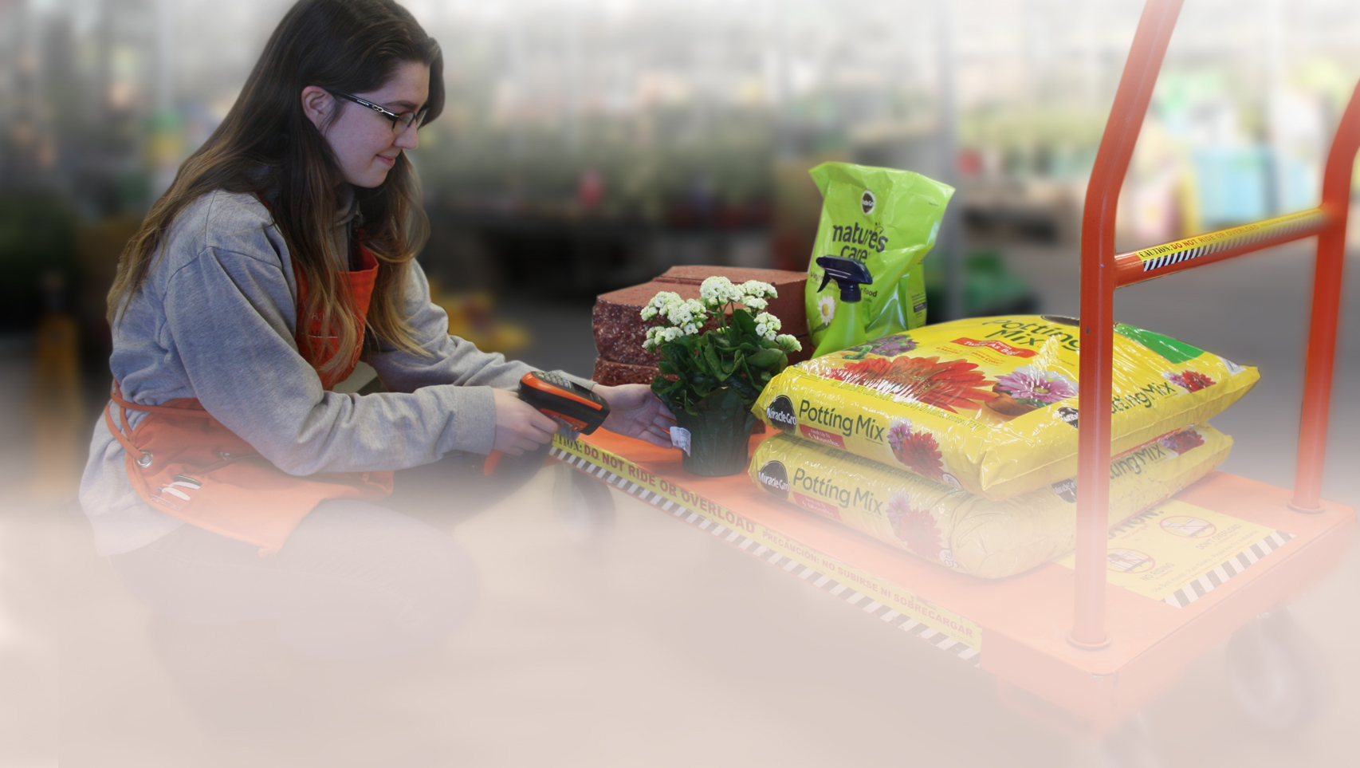
The Customer’s Experience is Our Greatest Competitive Advantage
CREATING A GREAT
CUSTOMER EXPERIENCE

Slide 14
The Customer Experience
Starts When They Pull Up
Our store presentation should be opening day ready every day
No trash or plant trays under tables
All unused hoses are put up
Carts are available
Associates are available and ready to help

Slide 15
Customer Experience
Weekend Schedule & Placement of Team
Associates should be stationed in the following areas:
Mulch Pit loader
General garden loader
Watering
Power aisle
Grills
Pavestone/bagged goods
Weekend MOD (DS that is not Garden)

Slide 16
Customer Experience
Weekend Garden MOD is responsible for:
Assigning associates to the different areas
Assigning breaks to associates
Ensure watering is getting done
Act as a greeter for the garden center
Help keep checkout lines down

Slide 17
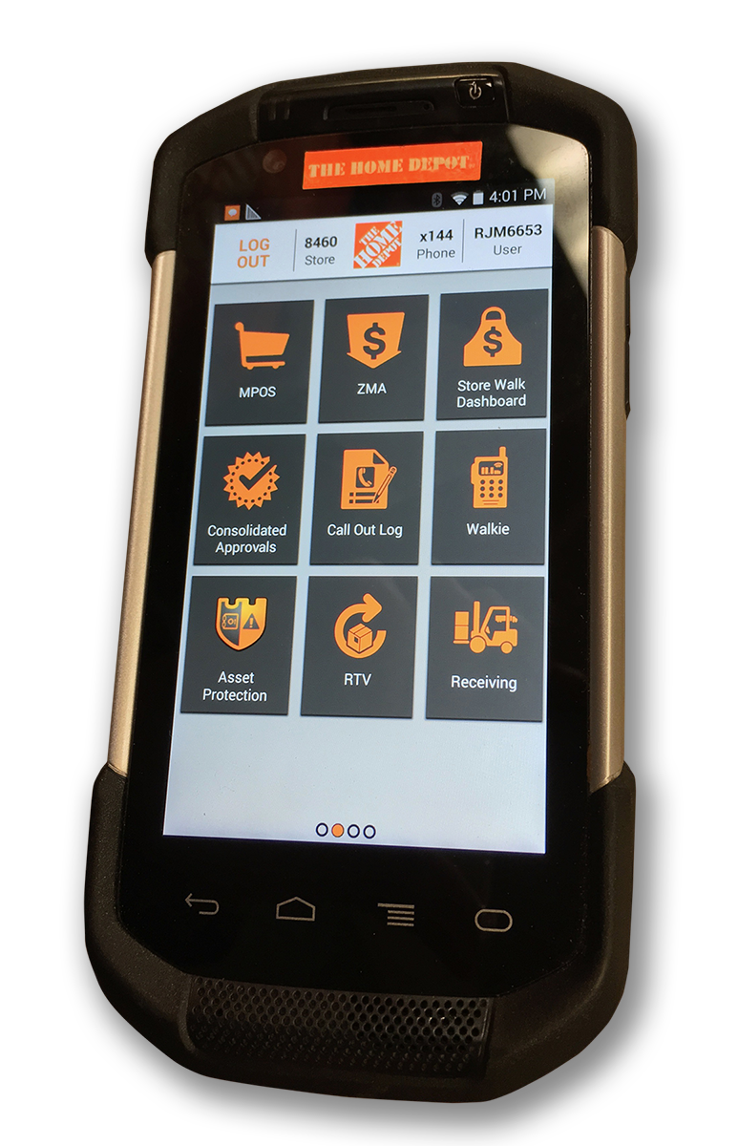
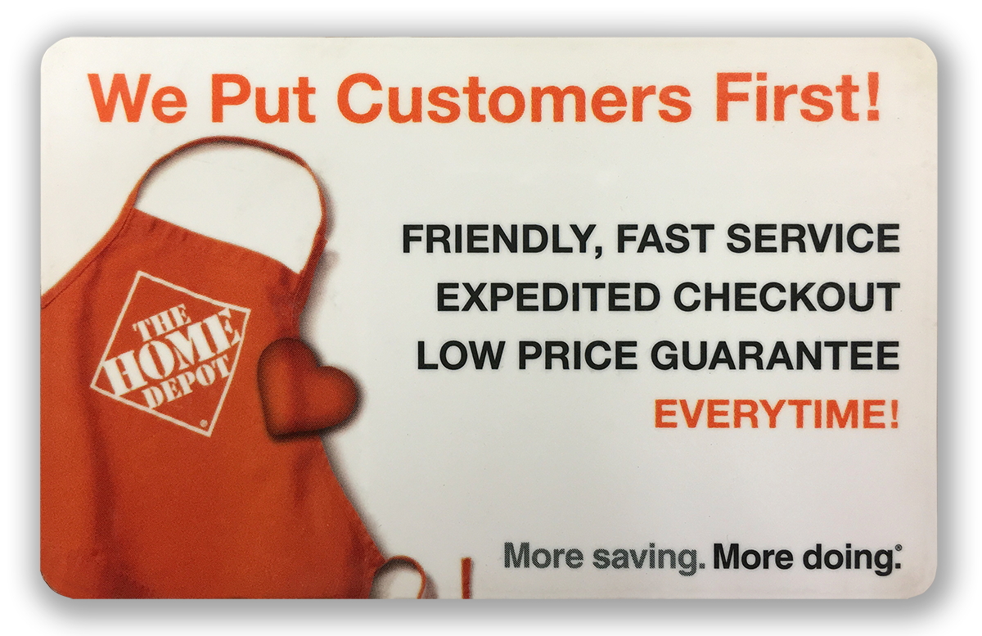
Customer Experience
All associates should know how to use MPOS and expedited checkout cards
Cleared expedited checkout cards should be available in the cashier hut

Slide 18
IN STOCK

Slide 19
Verify current on hands for your high volume SKU’s in soils, wall block, pavers, and mulch
Select one person to place all orders (D28 DS or Merchandising ASM)
Order up and maintain a minimum of 3 weeks supply of product
Check previous years sales for those weeks and ad 20%

Slide 20
Place orders in full truck loads only
If half truck orders are allowed remember that it has to be paired with another stores half truck order before it will ship
Do not place more than one truck load on the same order
Ensure cashiers are scanning every item

Slide 21
Place orders in full truck loads only
If half truck orders are allowed remember that it has to be paired with another stores half truck order before it will ship
Do not place more than one truck load on the same order
Ensure cashiers are scanning every item

Slide 22
Make a list of the items that are commonly mistaken by cashiers and post in the cashier hut
Include the SKU, description of item and how to tell it apart.
Make a sign for the sale items and post in cashier hut
When mulch is on sale put which brand
As colors sell through post that as well

Slide 23
Assembly
All items for assembly should be entered into Assemblers Inc. by Sunday at 2pm for that next week
All items should be dropped and spray painted with a designated assembly color and located in a designated area.
The spray paint identifies the items to be assemble. If it is not spray painted they should not be assembling it

Slide 24
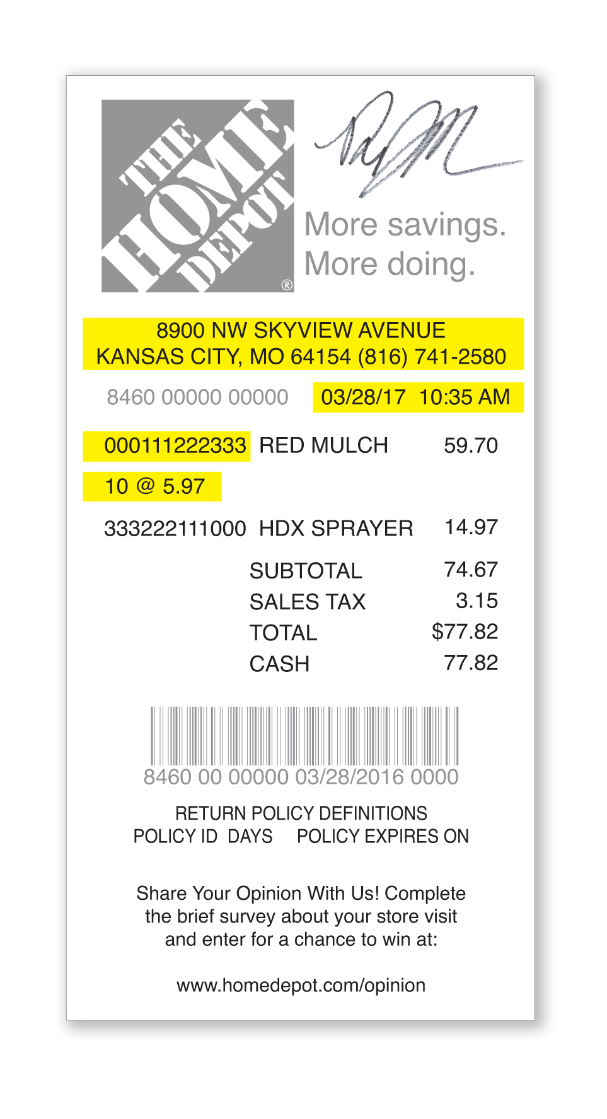
Receipt Checking
What to Look For
5
1
Store
Date and Time
SKU
Quantity
Initials
2
3
4

Slide 25
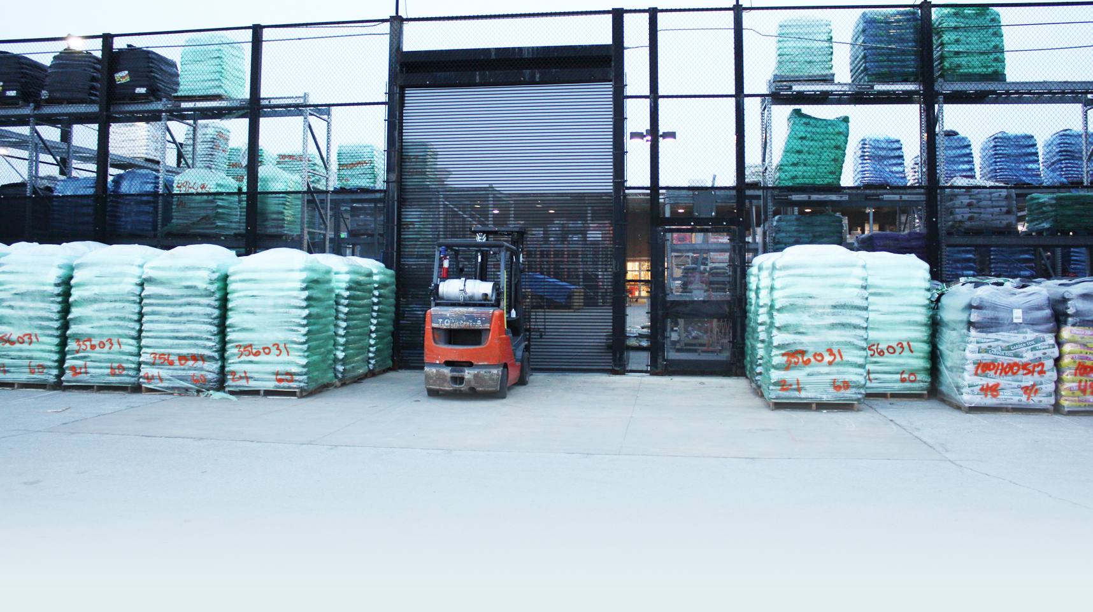
What is expected on the perimeter of the building?
OVERSTOCK

Slide 26
All pallets should inventory ready
That means pallets behind other pallets should be the same SKU as the pallet in front
Mulch should be stored closest to the parking lot for easier recovery
Should be sorted by brand and color
Have designated areas for pavers/wall block, bagged rock, and specialty soils

Slide 27
Receiving Trucks
Trucks should be received and processed by a receiving associate
The receiving associate then calls a card associate to get the invoice
That Garden associate then goes out and verifies what is on the truck matches the invoice
The associate then spray paints the SKU, date and quantity on the pallet
Once all that has been done then the truck can be unloaded

Slide 28
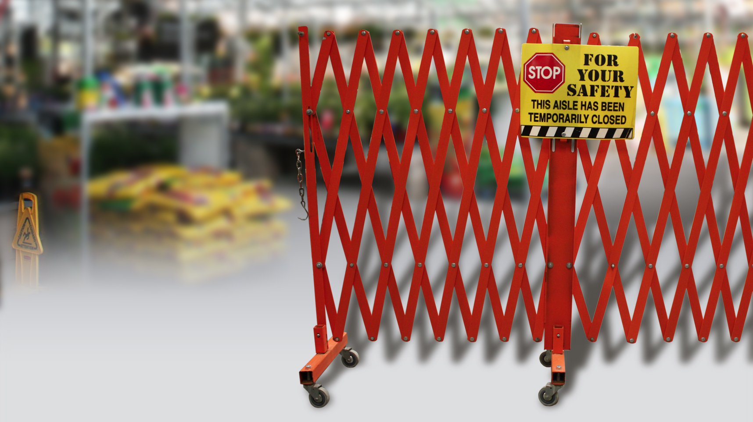
What is Expected?
SAFETY

Slide 29
Gates are in working order and attached to the end of the aisles
There are enough mobile gates in the store so 4 can be designated for garden center use only
Make sure sweep station and hazmat station are up to standard
Fertilizer bags and bag patches are stocked up and available

Slide 30
Contacts
Kelli – Cottage Gardens
816-379-6899
Brain – Natural Beauty
816-294-9645

